Slide 1
LINK STATE ROUTING

Slide 2
Task of each router
Discover its neighbours and learn their network addresses.
Set the distance or cost metric to each of its neighbours.
Construct a packet telling all it has just learned.
Send this packet to and receive packets from all other routers.
Compute the shortest path to every other router.

Slide 3
STEP 1 - Learning about the Neighbours
send a special HELLO packet on each point-to-point line.
router on the other end is expected to send back a reply giving its name(unique)

Slide 4
STEP 2 - Setting Link Costs
Special packet, ECHO, is used to determine the delay between two nodes
Round-trip time / 2 = estimated delay

Slide 5
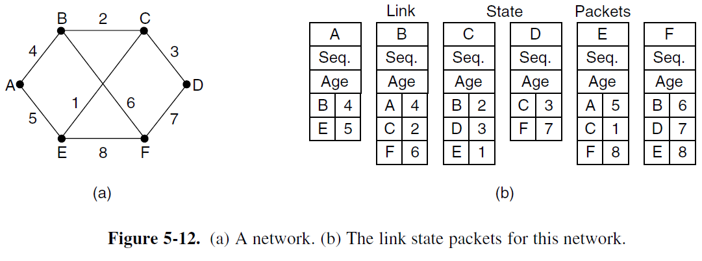
STEP 3 - Building Link State Packets
identity of the sender
sequence number
age
list of neighbours.

Slide 6
Building the link state packets is easy. The hard part is determining when to build them.
Build them periodically
Or
Build them when some significant event occurs

Slide 7
STEP 4 - Distributing the Link State Packets
All of the routers must get all of the link state packets quickly and reliably
Fundamental idea
Flooding

Slide 8
Damming Flooding
Sequence Number
Distinguish between old and new packet
Each packet contains a sequence number that is incremented for each new packet sent
Routers keep track of all the (source router, sequence) pairs they see
New packets forwarded
Old packets discarded
Packets with higher sequence number ➔ fresh
Age
Remove packets that are circulating that are aged
To tackle lost of sequence number due to various reasons, age is used
Decrement age every second
When age hits zero, packet discarded

Slide 9
On receiving an LSP, it is not flooded immediately. It is held in an area to wait a short while in case more links are coming up or going down
If another link state packet from the same source comes in before the first packet is transmitted, their sequence numbers are compared.
If they are equal, the duplicate is discarded.
If they are different, the older one is thrown out.
To guard against errors on the links, all link state packets are acknowledged.

Slide 10
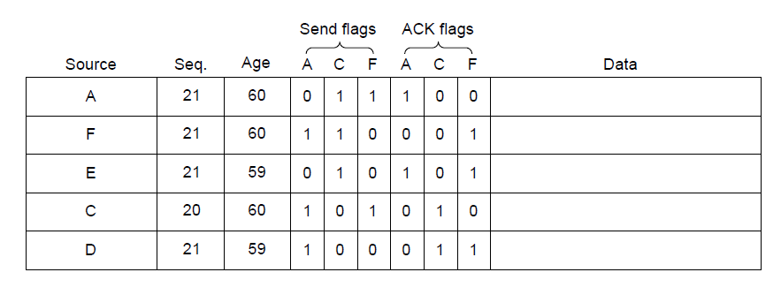
Distributing the Link State Packets
The packet buffer for router B in previous slide

Slide 11
Step 5 - Computing the New Routes
Each router has accumulated a full set of link state packets
Dijkstra’s algorithm can be run locally to construct the shortest paths to all possible destinations

